Slide 1




HackOrbit 2025
CodeRonin

Slide 2


Theme:
Artificial Intelligence and Machine Learning
Problem Statement:
Challenges of Non-Adaptive Traffic Light Systems in Cities
Fixed-timing traffic lights
No real-time traffic adaptation
Causes unnecessary delays
Leads to traffic congestion
increases fuel consumption
Poor traffic flow management
Problematic during peak hours
Inefficient with uneven traffic conditions

Slide 3


PROPOSED SOLUTION
An AI-powered dynamic traffic light management system that adapts signal timings in real-time based on live traffic density to optimize flow and reduce congestion.
Uses computer vision to detect and count vehicles (cars, bikes, rickshaws, tempos) from CCTV feeds.
Dynamically adjusts green light duration based on real-time traffic volume per lane.
Prioritizes high-traffic lanes and minimizes wait time on empty roads.
Can identify and prioritize emergency vehicles using advanced detection.
Analyzes traffic patterns across different times of day (morning, evening, night).
Supports deployment on edge devices (Raspberry Pi, Jetson Nano) or remote servers for scalability.

Slide 4


FLOWCHART / DIAGRAM
Video Footage from a traffic junction
Preprocess Video
Vehicle detection Model
Analyze Traffic density
Update Traffic Time Dynamically
START
END
Emergency
Vehicle detected

Slide 5
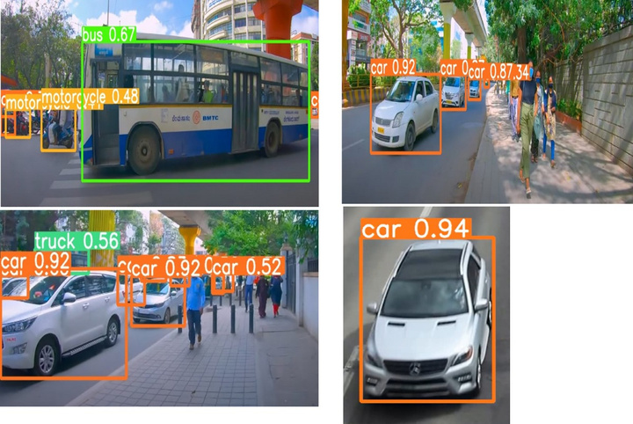

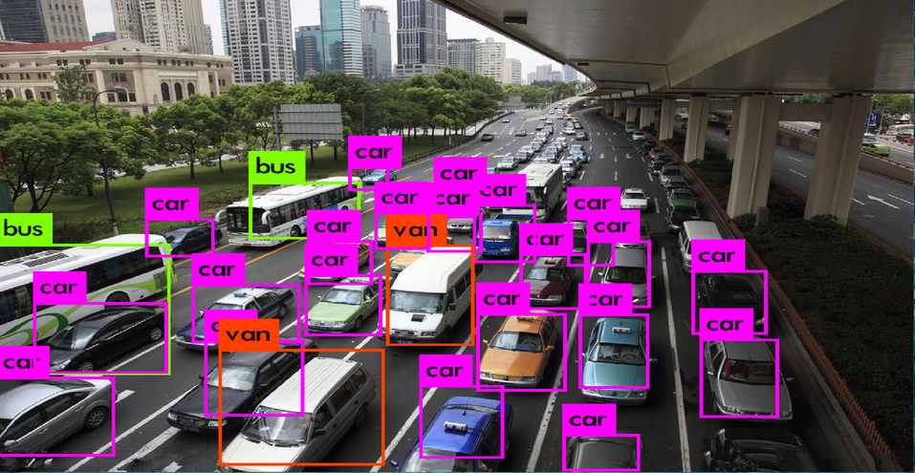






FLOWCHART STEPS EXPLAINED:
Video Capture: Live video stream from CCTV at traffic junction.
Preprocessing: Resize, normalize, and convert frames (if needed).
Vehicle Detection: Use models like YOLO/SSD to detect/count vehicles.
Traffic Analysis: Calculate traffic density per lane.
Emergency Check: Detect emergency vehicles (e.g., ambulance, fire truck).
If detected: Give immediate green signal.
If not: Proceed to adjust signals.
Dynamic Signal Timing: Allocate green light time based on traffic load.
Repeat Cycle: Continuously update in real-time.
SOFTWARE USED :

Slide 6


FEATURES:
🔴 Real-time traffic density analysis using AI
🟢 Dynamic & adaptive signal timing to reduce congestion
🚑 Priority green signal for emergency vehicles
🌙 Works in all lighting conditions (day & night)
🚗 Supports detection of multiple vehicle types (cars, bikes, tempos, rickshaws)
☁️💻 Deployable on cloud or edge devices (e.g., Raspberry Pi, Jetson Nano)
🗺️ Scalable to multi-junction city networks
Novelty:
🇮🇳 First to accurately detect Indian-specific vehicles like autorickshaws & tempos
🤖 Combines computer vision with real-time adaptive control
⚡ Flexible deployment on both cloud and edge, making it fast & cost-effective

Slide 7

DRAWBACK AND SHOWSTOPPERS
Detection accuracy decrease in evening.
Requires stable, high-quality video input.
High computational cost for real-time processing.
Needs modern cameras & infrastructure upgrades.
Detection errors may affect signal accuracy.
Relies on strong network connectivity.
Emergency vehicle detection may fail.
Requires regular hardware maintenance.

Slide 8

CodeRonin
TEAM MEMBERS:
Vipin Pratap
Email : s.pvimalpratap9458@gmail.com
Phone No.: 82181 20174
Ravi Singh
Email: ravis541242@gmail.com
Phone No.: 77229 98185

Slide 9
Thank you

